Slide 1


Slide 2

DEVELOPMENT
Analog and Mixed Signal
Design Tape-Out IC process

Slide 3

Agenda
Specification Definition
Circuit Design (Schematic Level)
Pre-Layout Simulation
Layout Implementation
Post-Layout Simulation
DRC, ERC, LVS Sign-Off
Final Tape-Out Package Preparation
Submission to Foundry
Fabrication & Silicon Validation

Slide 4

Overview
Analog integrated circuit (IC) design focuses on developing electronic circuits that handle continuous signals, such as varying voltages and currents, rather than discrete digital signals.
Analog circuits are tailored to perform specific functions such as amplification, filtering, modulation, and various forms of signal conditioning or processing.

Slide 5
Overview
Specification Definition
Circuit Design (Schematic Level)
Pre-Layout Simulation
Layout Implementation
Post-Layout Simulation
DRC, ERC, LVS Sign-Off
Final Tape-Out Package Preparation
Submission to Foundry
Fabrication & Silicon Validation

Slide 6
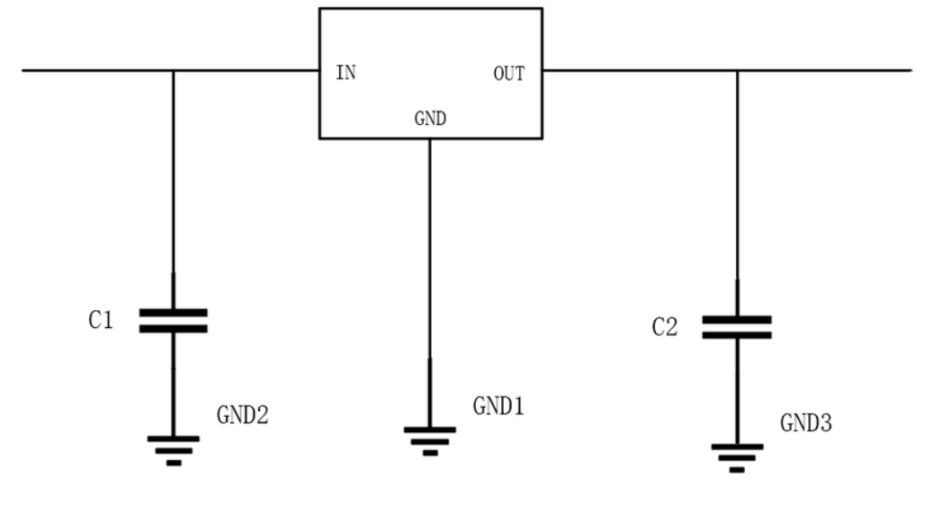
1. Specification Definition
Define performance metrics: gain, bandwidth, noise, power, linearity, etc.
Set process node, supply voltage, temperature range, etc.
Choose PDK (Process Design Kit) from foundry

Slide 7
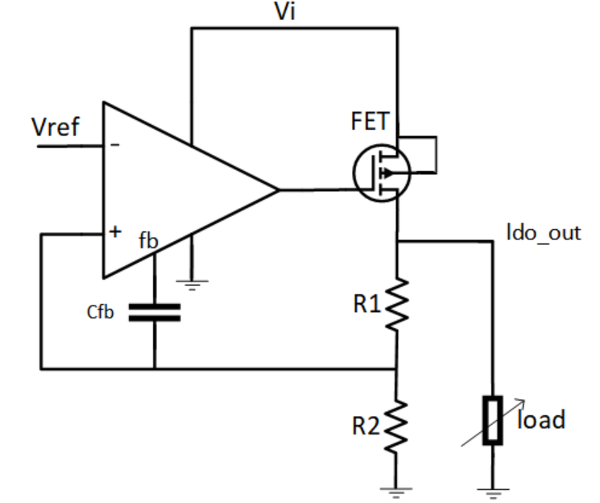
2. Circuit Design (Schematic Level)
Design transistor-level schematics using tools like Cadence Virtuoso or Custom Compiler (Synopsys).
Perform hand calculations and simulations.
Optimize for corners (PVT variations), noise, and mismatch

Slide 8
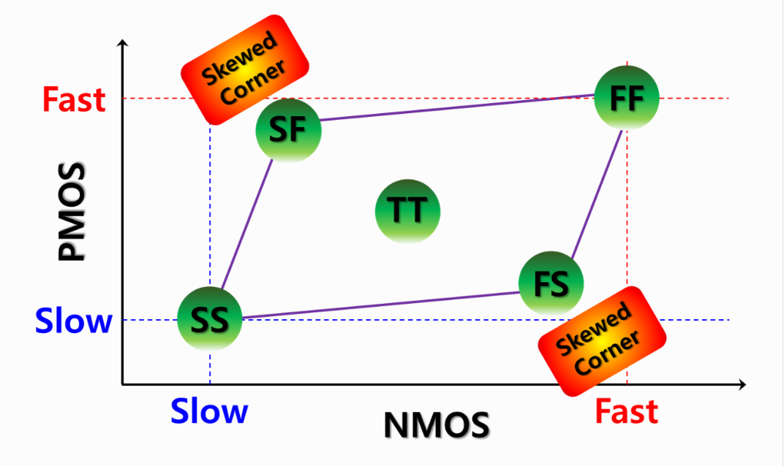
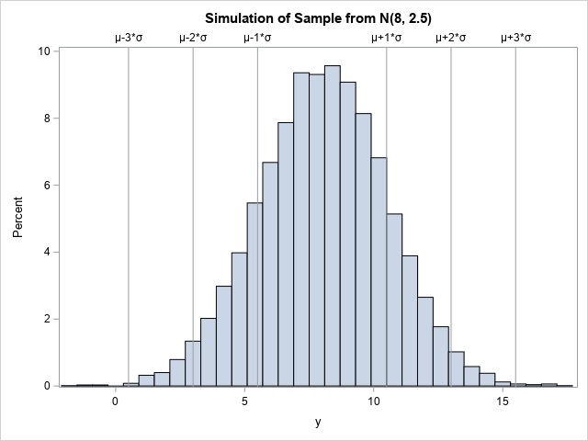
3. Pre-Layout Simulation
Use SPICE simulation tools (Spectre, HSPICE, etc.).
Validate performance across process corners (TT, FF, SS, SF, FS).
Monte Carlo analysis for mismatch and statistical variations.

Slide 9
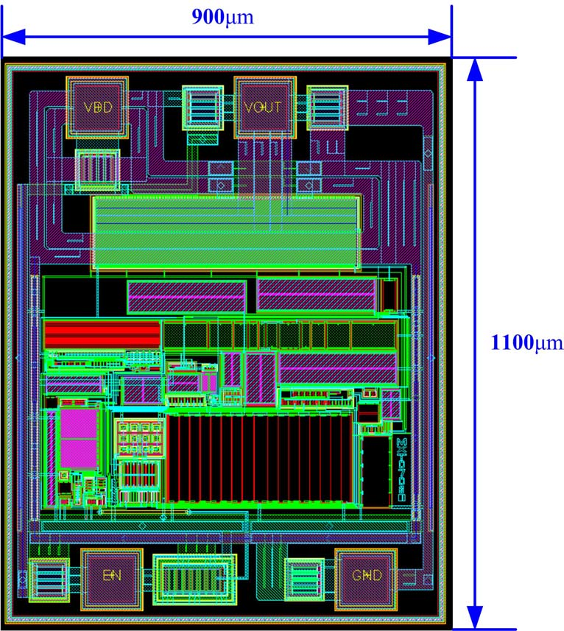
4. Layout Design
Draw physical layout manually (often) for analog blocks.
Emphasize symmetry, matching, parasitic minimization.
Use layout techniques: common-centroid, interdigitated, guard rings.

Slide 10
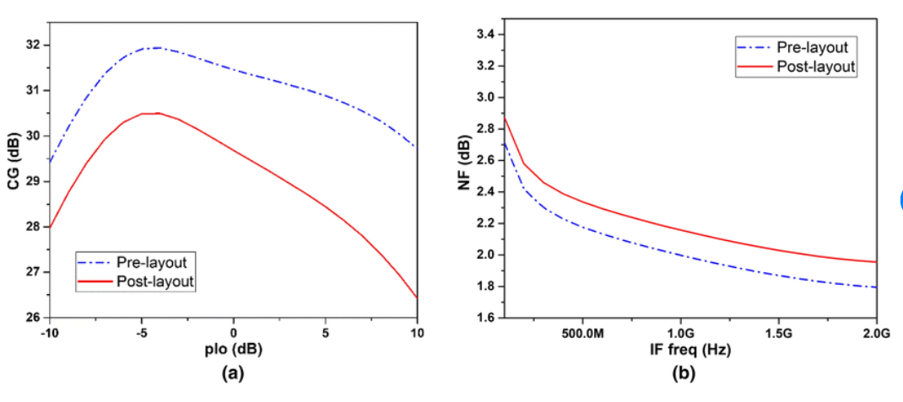
5. Post-Layout Simulation (LVS & PEX)
LVS (Layout vs. Schematic): Ensure layout matches schematic.
PEX (Parasitic Extraction): Extract parasitics (RC) from layout.
Run post-layout simulations to confirm performance with parasitics.

Slide 11
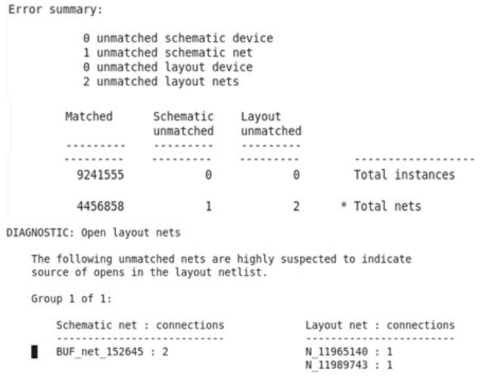
6. DRC, ERC, LVS Sign-Off
DRC (Design Rule Check): Check design against foundry rules.
ERC (Electrical Rule Check): Identify violations like floating nodes.
LVS must pass to proceed.
All checks must be clean before tape-out.

Slide 12
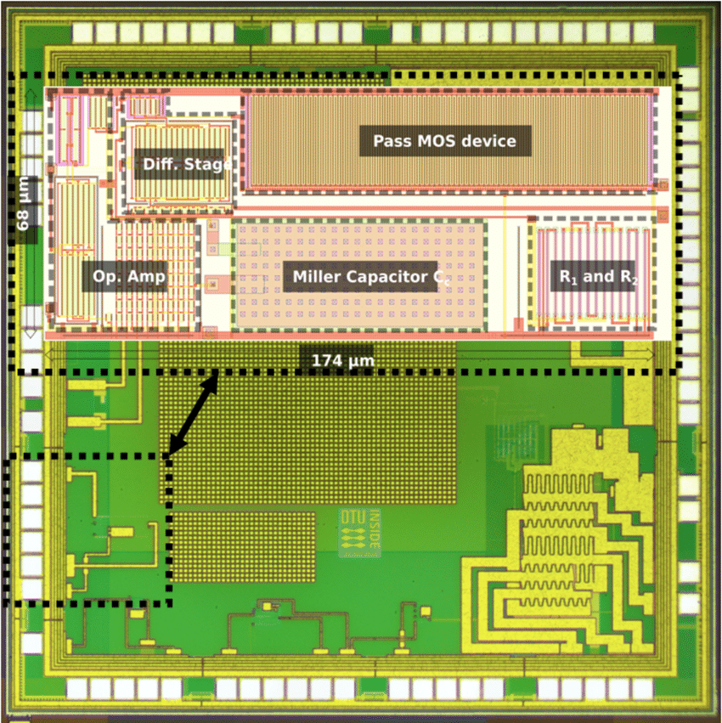
7. Final Tape-Out Package Preparation
Generate GDSII or OASIS files for fabrication.
Include documentation, netlists, verification reports.
Perform sign-off checklist: ESD protection, metal density, filler cells.

Slide 13
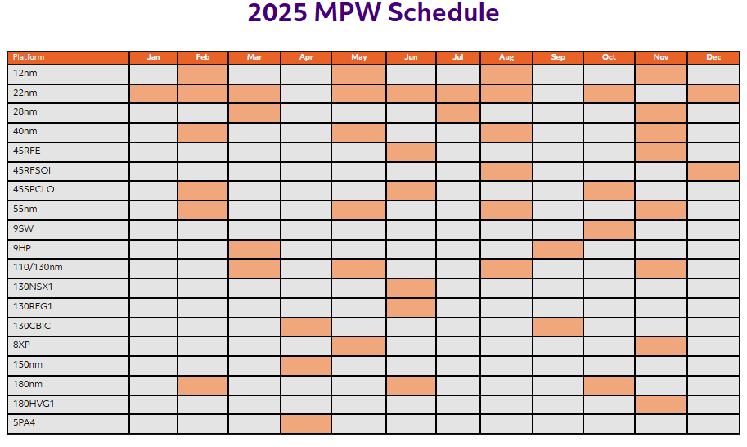
8. Submission to Foundry
Send GDS/OASIS and sign-off data to foundry.
Foundry reviews (pre-tapeout checks) and schedules for mask generation and fabrication.

Slide 14
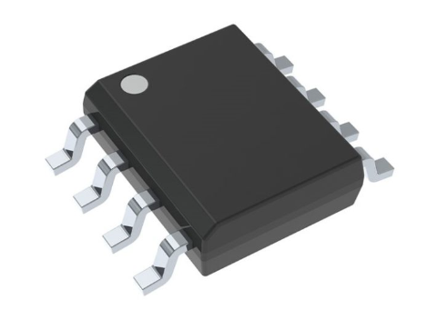
9. Fabrication & Silicon Validation
Masks are created and wafer fabrication begins.
Once dies are ready, silicon validation and testing start.
Measured results are compared with simulations.

Slide 15



